Slide 1
ANALYSIS OF SEDIMENTATION AND PROJECTED WATER DEPTH LEVELS IN RESACAS OF BROWNSVILLE, TEXAS
May, 2019
Herman Ramsden

Slide 2
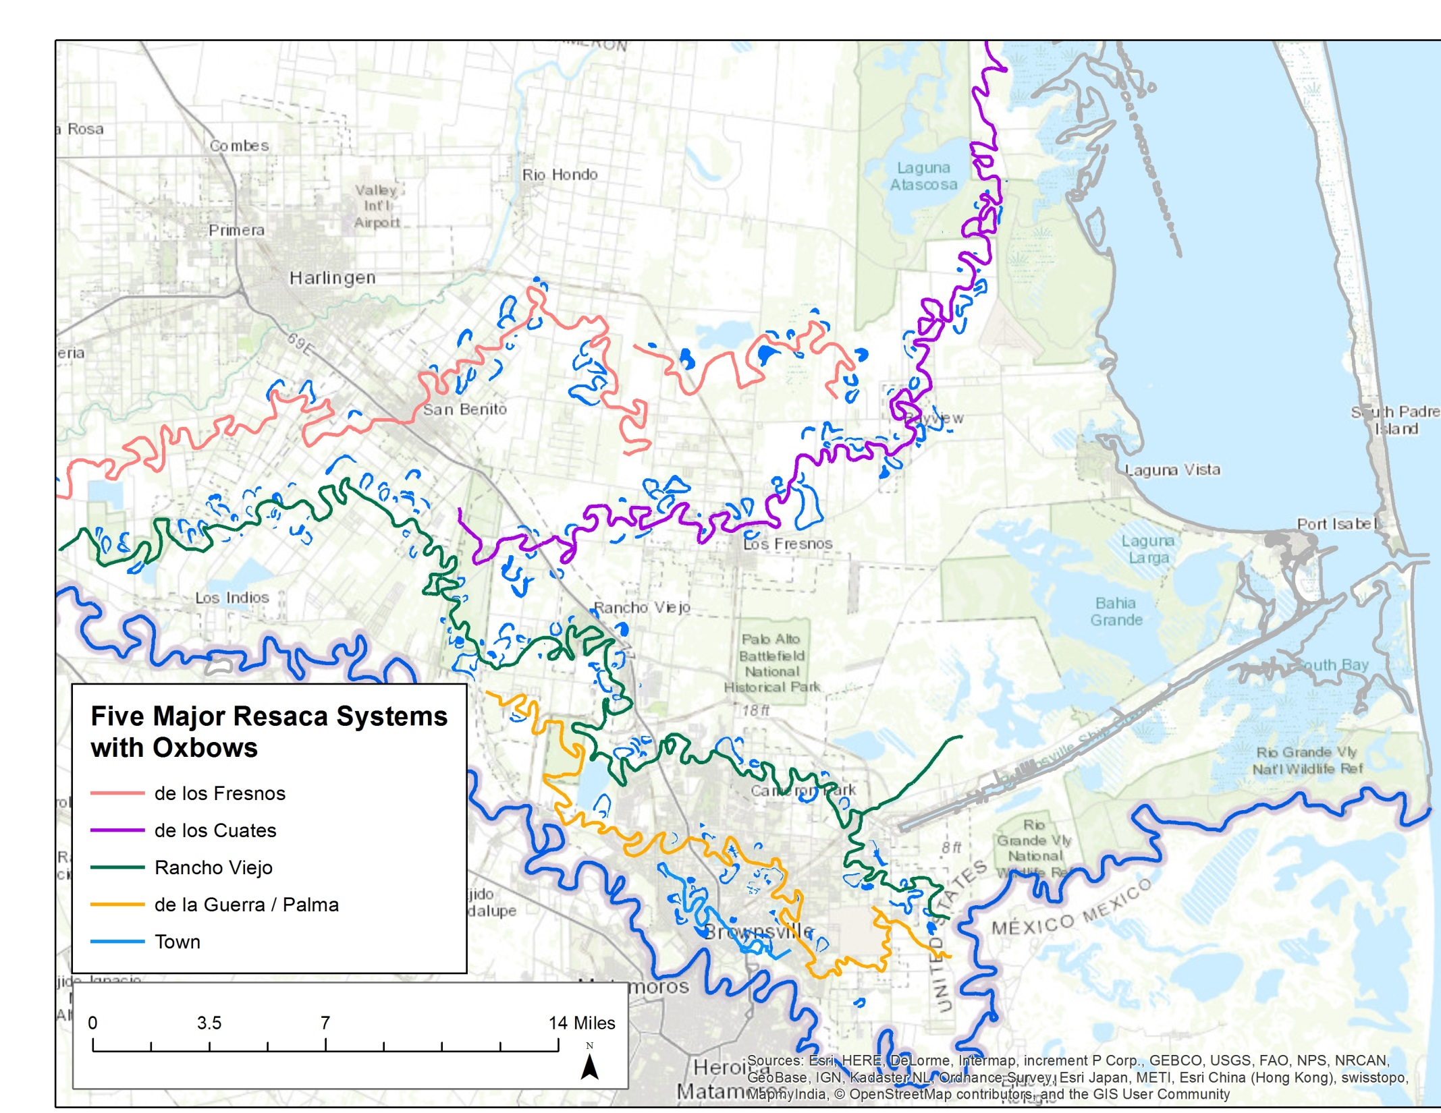
Study area
Population: 183,000
Annual precipitation: 25 – 30 inches
Evaporation rate: 55 – 65 inches
5 Resaca systems:
Resaca de los Fresnos
Resaca de los Cuates
Resaca del Rancho Viejo
Resaca de la Guerra
Town Resaca
Notes:
only the three southernmost Resaca systems have been assessed by the Brownsville PUB and other organizations such as the U.S. Army Corps of Engineers. Historical data were not found for the northern two resaca systems (de los Cuates and de los Fresnos). As the purpose of this study is to evaluate changes to the system based on historical data such as depth, sediment thickness, and other parameters, this scope focuses on the three southernmost resaca systems

Slide 3
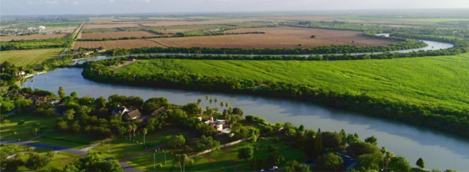
Resacas play vital roles in our study area
Flood protection.
Raw water storage.
Irrigation conveyance.
Habitat for bird / wildlife species.

Slide 4
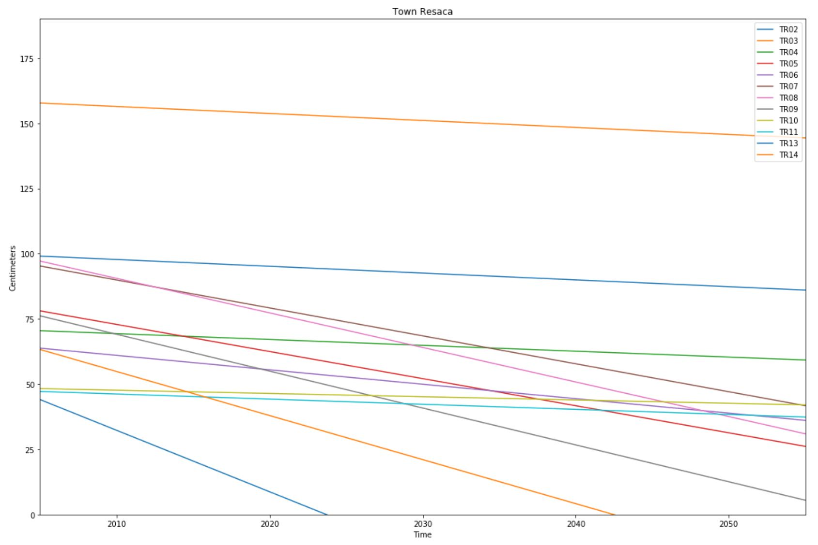
Projected Water Depth Town Resaca
Projected Water Depth = Current Water Depth – Sedimentation rate
Where Sedimentation rate = (Sediment thickness 1976 – Sediment thickness 2004) / 28

Slide 5
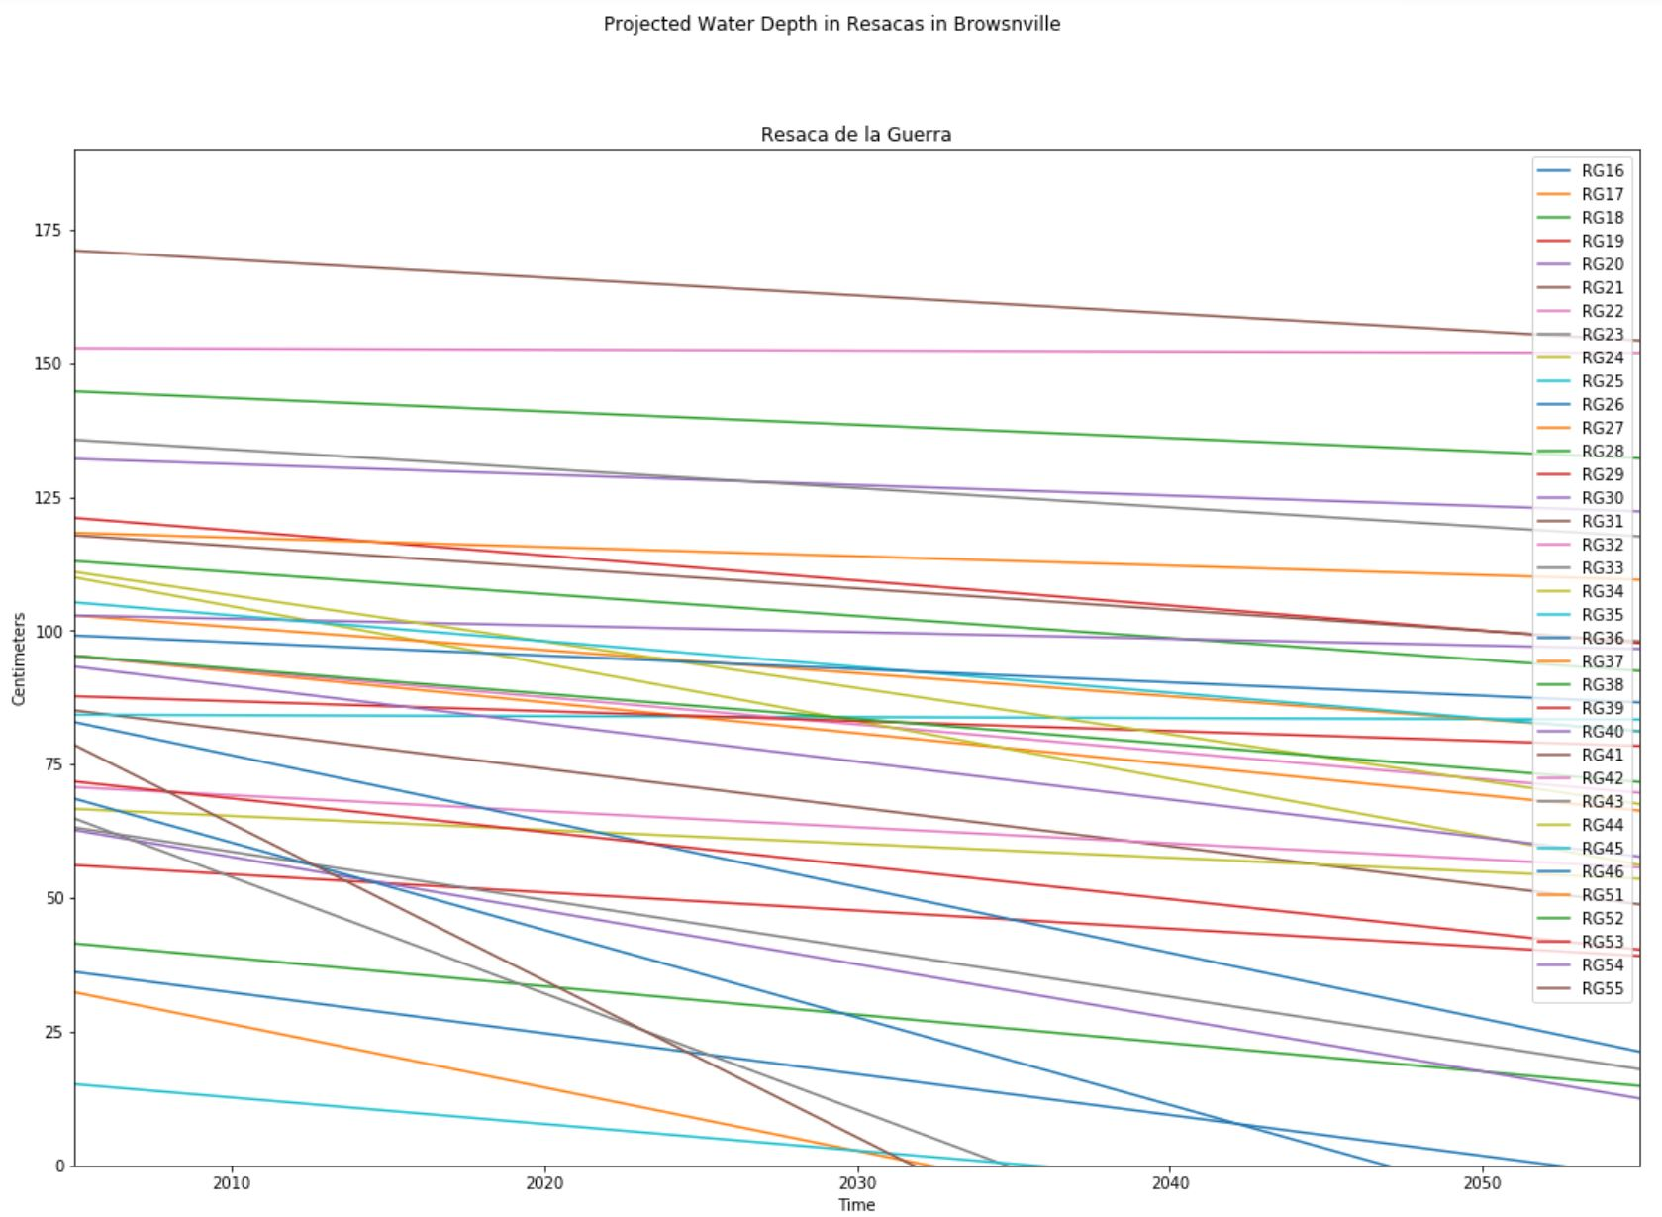
Projected Water Depth Resaca de la Guerra

Slide 6
Status of Town Resaca and Resaca de la Guerra according to the projected water depth.
Status | Pools
Critical (50 years or less) | TR13, TR14, RG16, RG17, RG18, RG27, RG34, RG36, RG57
Moderate (50 – 200 years) | TR05, TR06, TR07, TR08, TR19, RG19, RG20, RG21, RG22, RG24, RG28, RG33, RG35, RG37, RG55
No risk ( > 200 years) | TR02, TR03, TR04, TR10, TR11, RG23, RG25, RG26, RG29, RG30, RG31, RG32, RG38, RG39, RG40, RG41, RG42, RG43, RG44, RG46, RG51, RG52, RG53

Slide 7
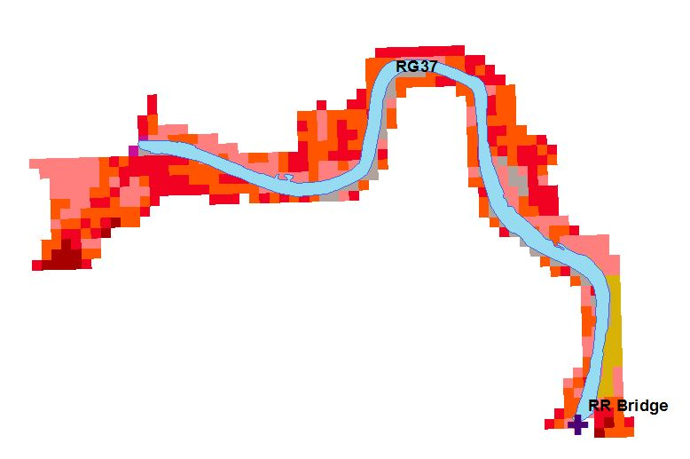
Analysis of Covariance(ANCOVA)
Sedimentation rate (response variable)
Population
Connection Structures
Pool Length
Sewershed Area
Urbanization
Pool Area
Variable | Value
Sediment thickness | 31.9 cm
Pool area | 97,567 m2
Pool length | 2.3 km
Connection structure | Rail Road Bridge
Urbanization | 83.1%
Sewershed area | 491,155 m2
Population | 875 habitants

Slide 8
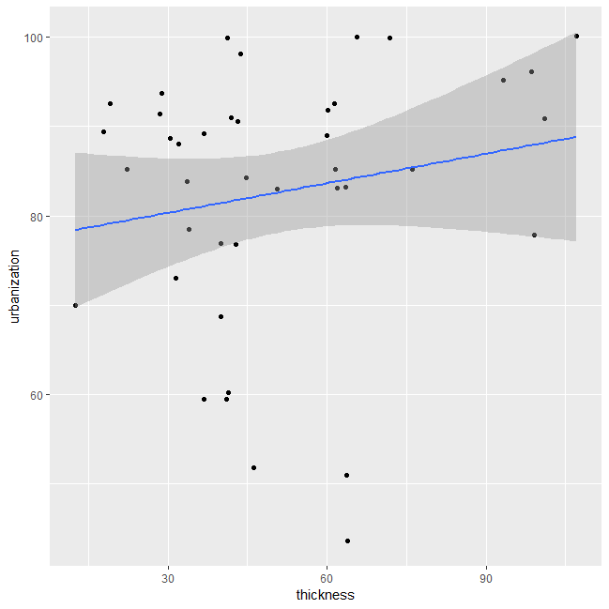
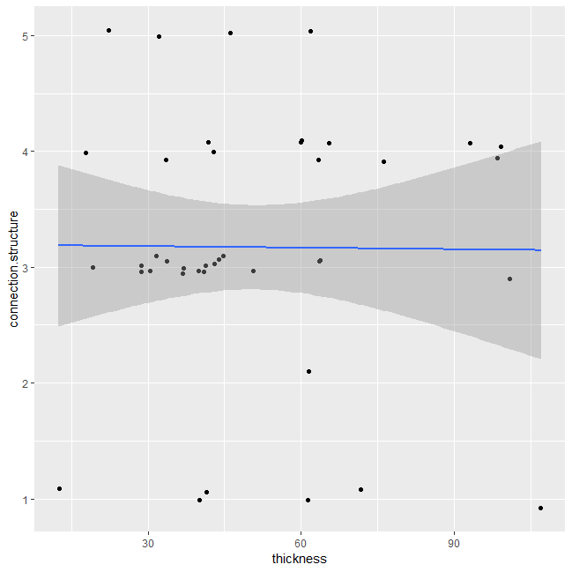
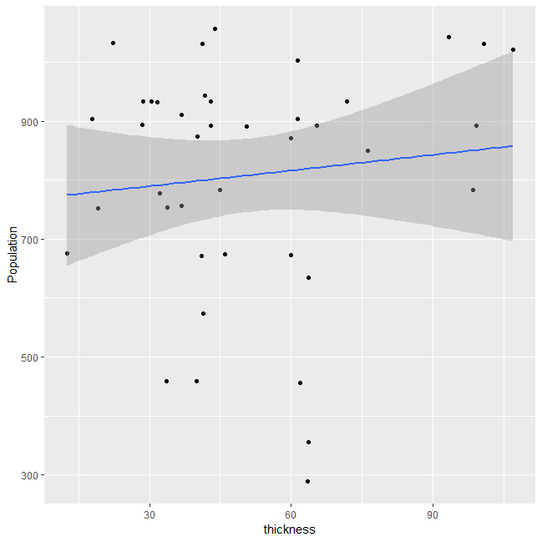
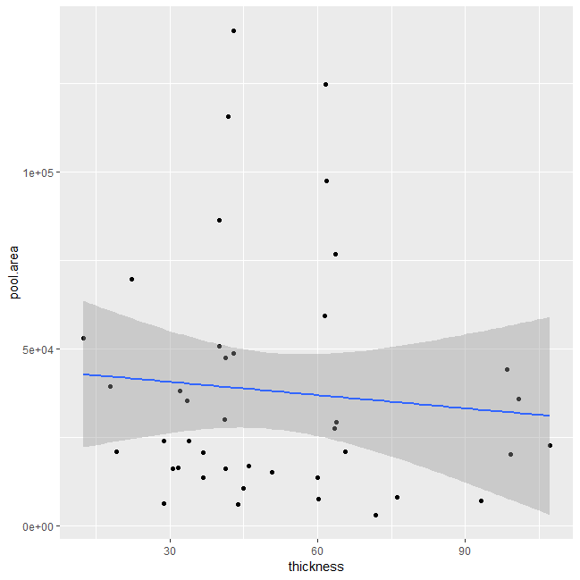
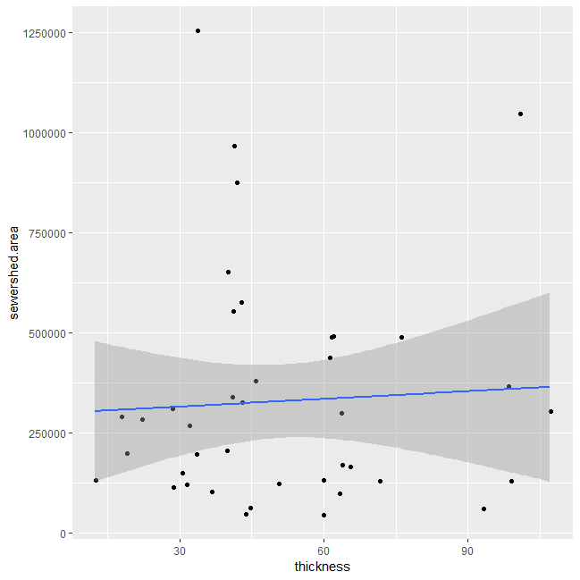
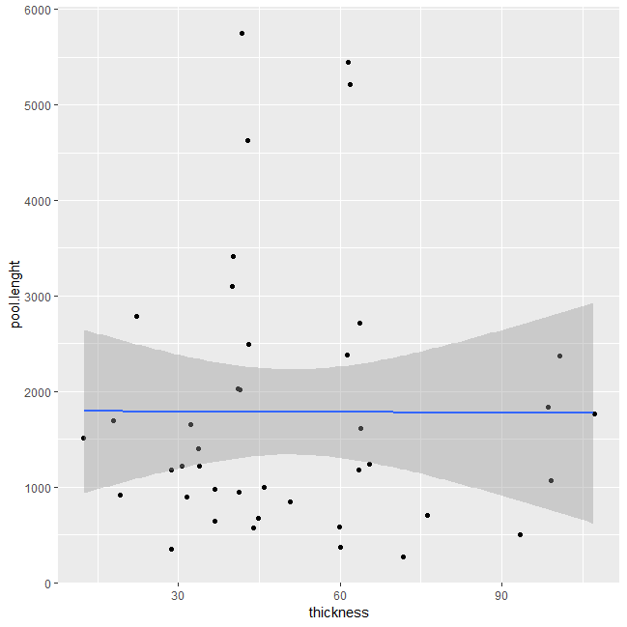
Correlation test
Sediment Thickness vs Urbanization = 0.1826
Sediment Thickness vs Connections = 0.0089
Sediment Thickness vs Population = 0.1074
Urbanization has the highest correlation coefficient
Population has the second highest correlation coefficient
Pool area and pool length have negative coefficients
Sediment Thickness vs Pool area = -0.0876
Sediment Thickness vs Sewershed = 0.0533
Sediment Thickness vs Pool length = -0.0034

Slide 9
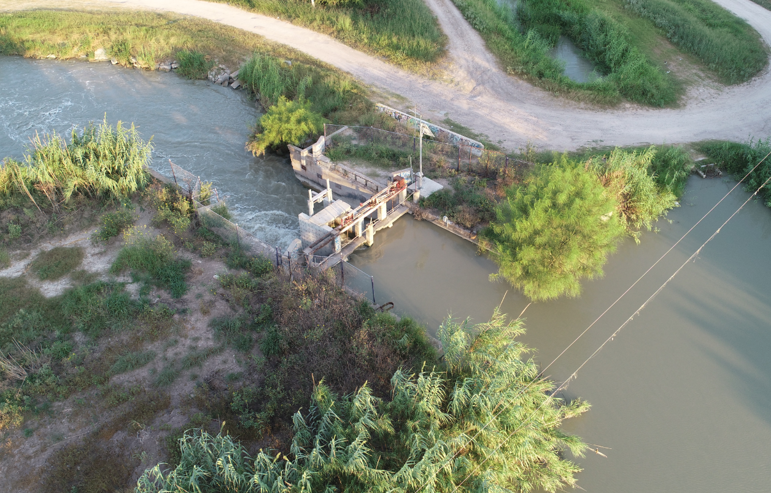
Hydraulic structures
Located where resacas are cut off by streets.
Designed to allow flow between the in-line pools or to maintain water levels
Types:
Weir
Box Culvert
Bridge
Reinforced concrete pipe
Notes:
There is a variety of hydraulic structures along the systems some are designed to allow flow between the inline pools and some designed to maintain water levels, others play an important role on storm water management and flood protection.

Slide 10
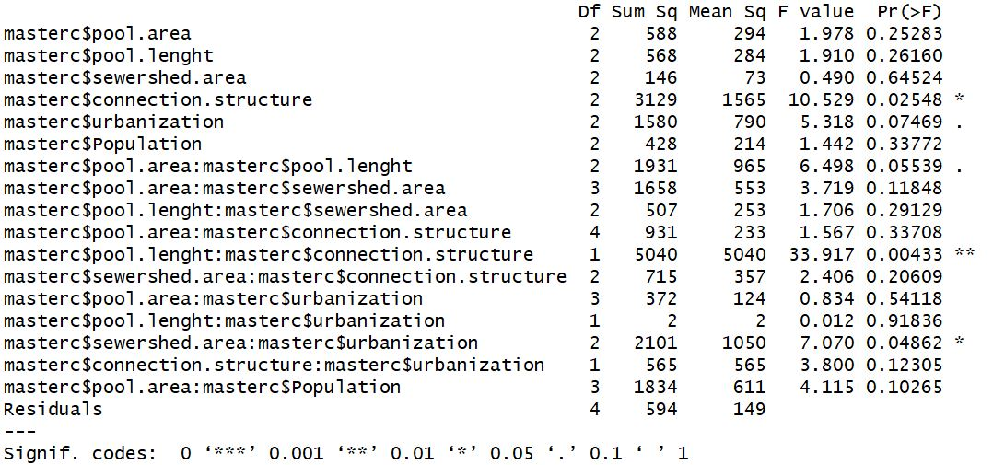
ANCOVA results
Statistically significant factors:
Connection structures
Interception of Pool Length and Connection Structure
Interception of Sewershed area and Urbanization

Slide 11
In other words… sediment thickness will be higher in:
Long resacas
Connection structure with reduced flow
Large sewershed
High urbanization

Slide 12
Questions

